Slide 1



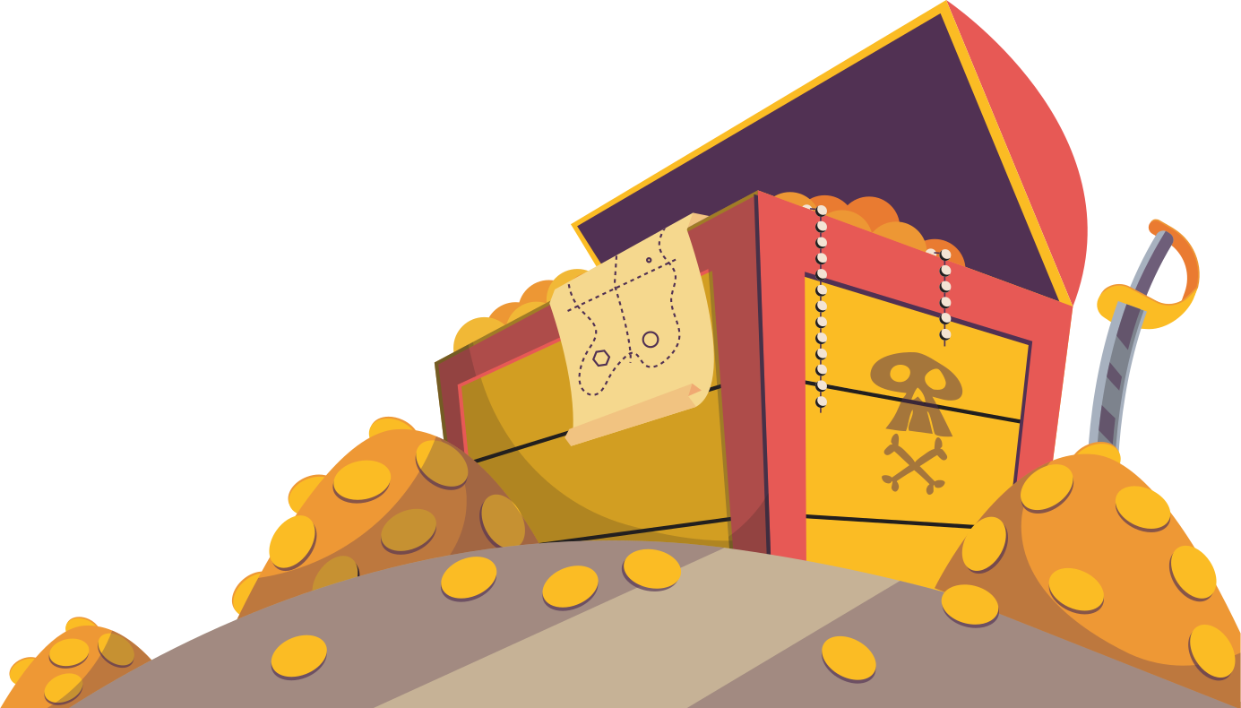

Treasure Hunt
Presentation
Let's start

Slide 2






Introduction
•What is the Treasure Hunt Game?
•- A grid-based game built using Python and Pygame.
•- Navigate through the grid to find the treasure while avoiding obstacles.
Objective of the Game
•- Win: Find the treasure on the grid.
•- Lose: Hit an obstacle before finding the treasure.
Technology Used
•- Programming Language: Python
•- Libraries: Pygame, Random

Slide 3


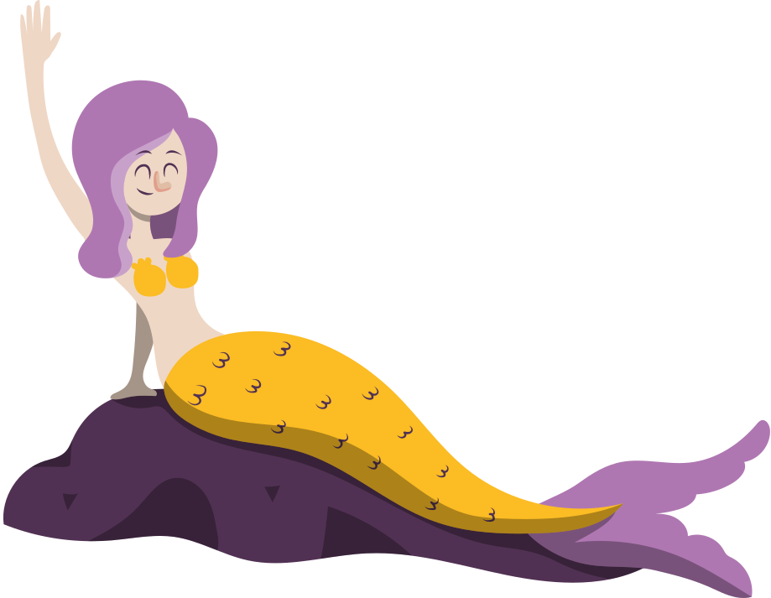
•Interactive grid-based gameplay.
•Randomly placed obstacles and treasure for replayability.
•Smooth navigation using arrow keys.
•Dynamic feedback for winning or losing.
—GAME FEATURES

Slide 4
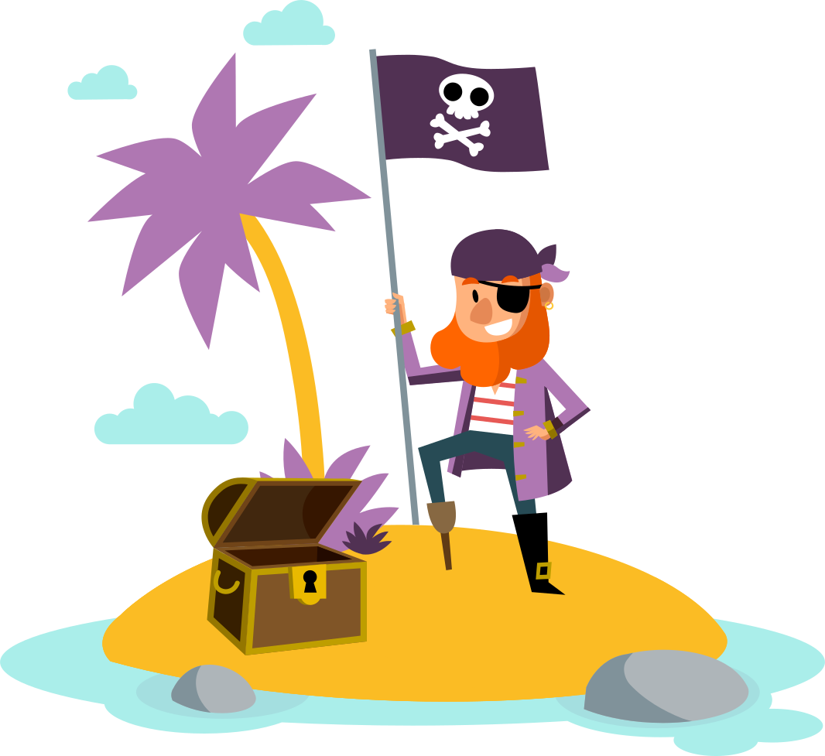
YOU WILL GET 3 OPTIONS.
LIKE LEVELS
—GAME START

Slide 5




Our games
LEVEL EASY
LEVEL MEDIUM
LEVEL HARD

Slide 6



Level Easy : Jungle Explorer
Step into the lush greenery of an enchanted jungle, where the treasure lies hidden beneath the ancient trees. As an explorer, you’ll navigate through 30 obstacles like fallen logs, muddy patches, and harmless wildlife. Each obstacle tests your quick thinking and basic problem-solving skills, making this level perfect for beginners. The goal is to reach the hidden treasure chest guarded by playful monkeys. Keep an eye out for helpful clues scattered along the way!

Slide 7






















Challenge
Navigate through simple puzzles like finding a way around logs.
Follow easy-to-spot clues.
Overcome light physical barriers like small rivers using stepping stones.

Slide 8



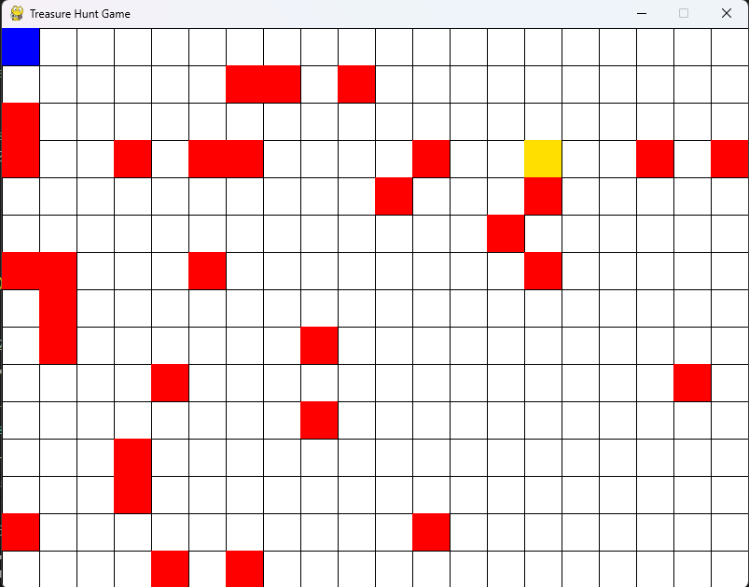


Easy Level: Jungle Explorer
GAMEPLAY

Slide 9
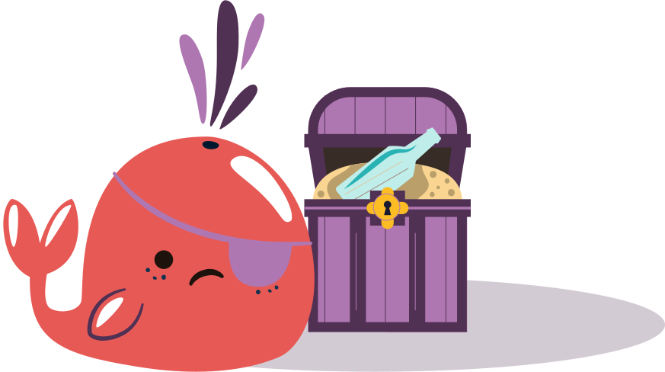
Level Medium: Desert Dare
Venture into the scorching heat of the mysterious desert. In this level, the treasure lies buried deep within a long-forgotten oasis. Along the way, you must tackle 45 obstacles, including sandstorms, hidden quicksand, and tricky mirages. Watch out for cryptic riddles and subtle hints to guide you closer to the goal. This level demands moderate problem-solving skills and a keen sense of direction.

Slide 10
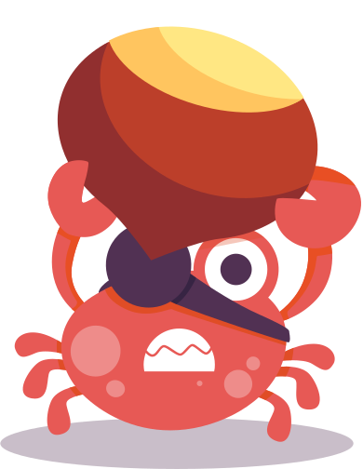
Challenge
Solve mid-level puzzles like finding the correct path from a maze of dunes.
Manage time and resources to avoid dehydration.
Decipher hieroglyphics and ancient codes to unlock paths.

Slide 11
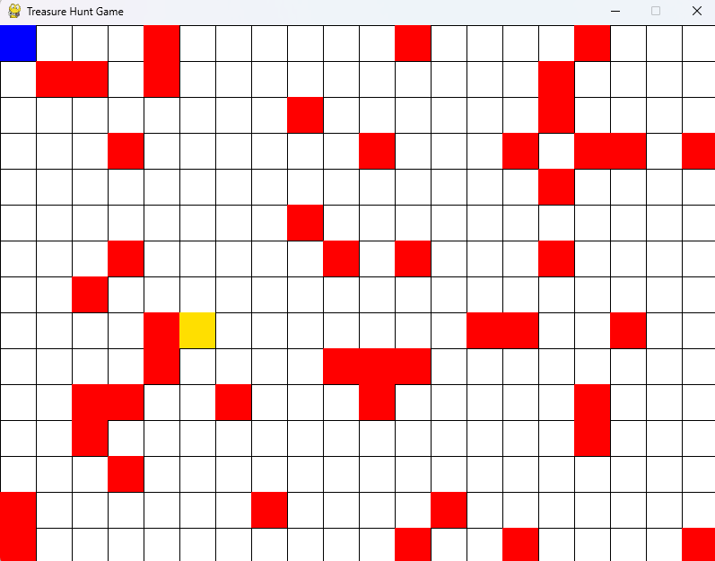
Level Medium: Desert Dare
GAMEPLAY

Slide 12
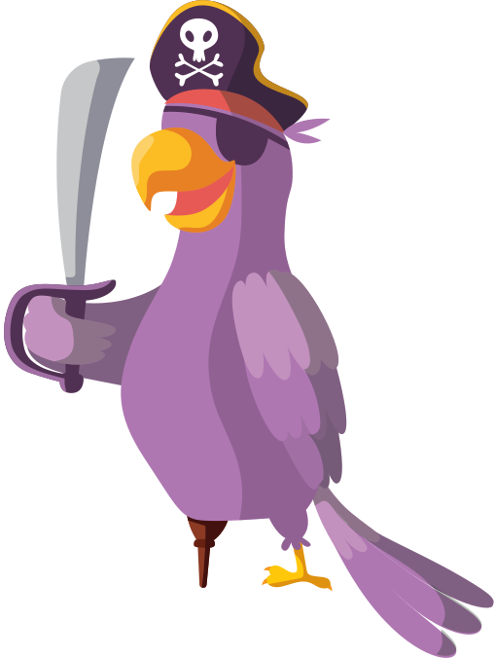
Level Hard: Mountain Madness
Embark on a daring adventure to scale the treacherous peaks of a snowy mountain. At this level, the treasure is hidden in an icy cavern guarded by an ancient mystery. With 60 obstacles to overcome, including avalanches, unstable bridges, and hidden traps, only the bravest can conquer this challenge. Be prepared for complex puzzles, intense decision-making, and swift reflexes.

Slide 13



Challenge
Solve advanced logic puzzles to deactivate traps.
Use limited tools to traverse icy terrain and climb dangerous cliffs.
Identify hidden paths and decode challenging clues.

Slide 14
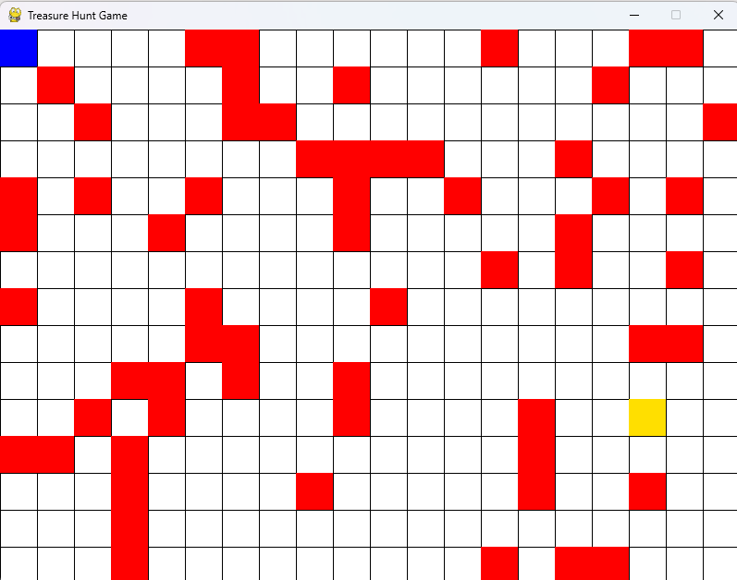
Level Hard: Mountain Madness
GAMEPLAY

Slide 15
AHOOOYYY

Slide 16



WHAT IF?
Navigate through many obstacles like fallen logs, muddy patches, and friendly wildlife, all while searching for the hidden treasure chest. But beware: if you hit an obstacle, your adventure ends!

Slide 17




Ooops!

Slide 18


WHAT IF?
The journey involves navigating around many obstacles, including fallen logs, mud puddles, and friendly wildlife. Stay alert! A single misstep into an obstacle ends your quest. But if you reach the treasure chest and “hit” it, the game will declare you the winner, unlocking the jungle’s secrets and rewards!
Get my GOLD

Slide 19



That’s great!

Slide 20


Game Features
•- Interactive grid-based gameplay.
•- Randomly placed obstacles and treasure for replayability.
•- Smooth navigation using arrow keys.
•- Dynamic feedback for winning or losing.

Slide 21

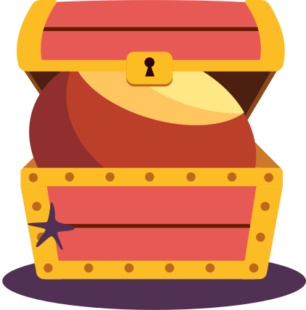

Code Structure Overview
•1. Initialization: Import libraries, set screen dimensions and colors.
•2. Game Logic: Generate obstacles and treasure, detect collisions.
•3. Rendering: Display game elements (grid, player, treasure).
•4. Game Loop: Continuously run until game over or quit.

Slide 22



Future Enhancements
•- Adding levels with increasing difficulty.
•- Introducing time limits or bonus points.
•- Multiplayer functionality.

Slide 23
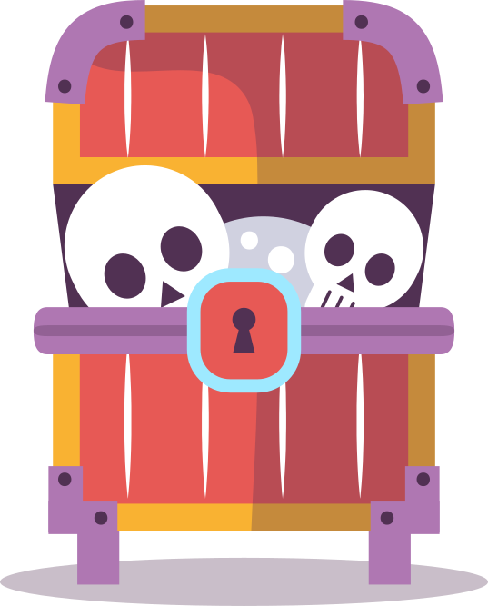

Conclusion
•- A fun, interactive game showcasing team collaboration and Python skills.
•- Built from scratch with dynamic gameplay and logical mechanics.

Slide 24


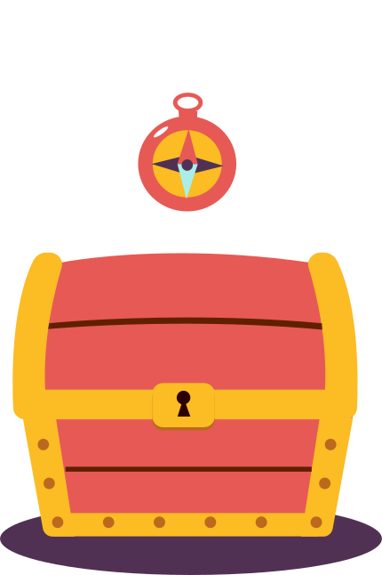

Yaaaay!

Slide 25





Our team
MD. Rahmatullah Ashik
ID: 0432220005101007
5A
Ribben Sharma
ID: 0432220005101028
5A
Tassnuba Tamim
ID: 0432220005101014
5A
Abdullah AL Numan
ID: 0432220005101039
5A

Slide 26



Acknowledgements
Special thanks to our mentors and peers for guidance and support.

